Slide 1
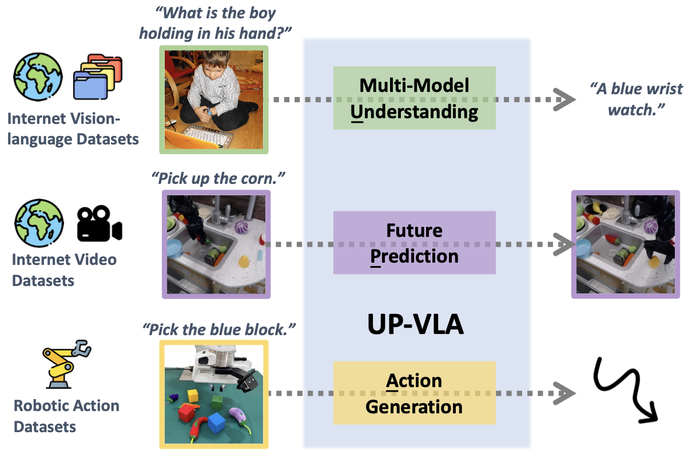
01
UP-VLA: A Unified Understanding and Prediction Model for Embodied Agent
• Motivation: recent VLA models leverage VLMs, which focus on high-level semantic content and neglect low-level features, limiting their ability to capture detailed visual and spatial information.
• What to unify and why: a Unified VLA model training with both multi-modal Understanding and future Prediction objectives, enhancing both high-level semantic comprehension and low-level spatial understanding.
Zhang et al., UP-VLA: A Unified Understanding and Prediction Model for Embodied Agent, ICML 2025

Slide 2
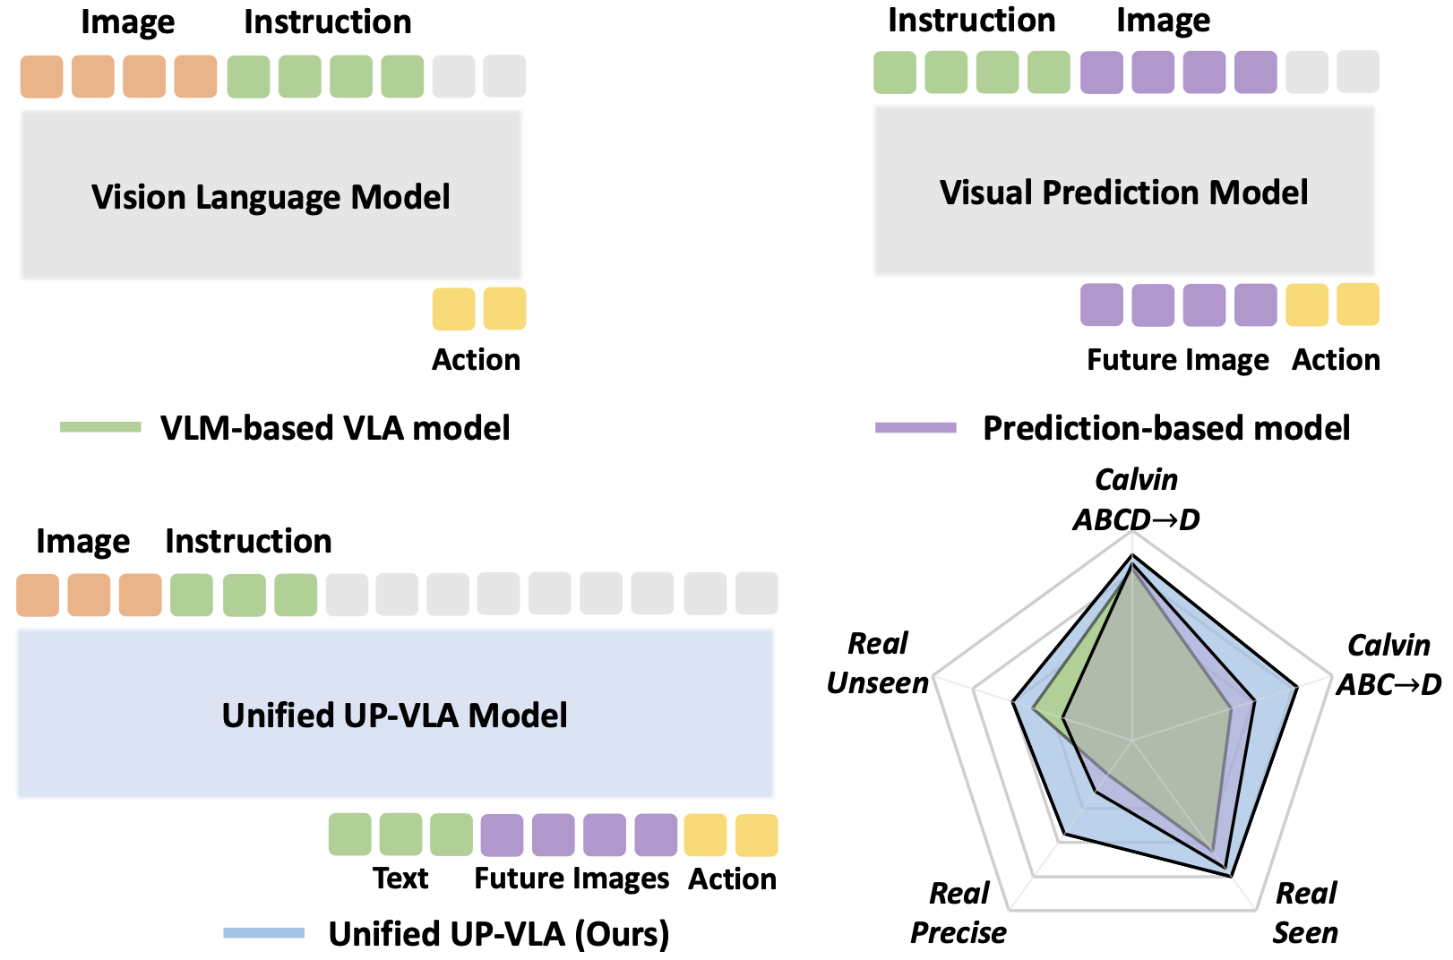
02
VLM-based model, Prediction-based model vs. UP-VLA
• VLM-based model:
✅ in-distribution multitask settings
✅ real-world generalization task
❌ adaptation and precise control
• Prediction-based model (World model):
⬆️ adaptation and precise control
• UP-VLA:
✅ in-distribution multitask settings
✅ real-world generalization task
✅ adaptation and precise control
ABCD→D, Real Seen: in-distribution multitask learning capabilities
Real unseen: real-world semantic generalization
ABC→D, Real Precise: adaptation and precise control abilities
Zhang et al., UP-VLA: A Unified Understanding and Prediction Model for Embodied Agent, ICML 2025

Slide 3
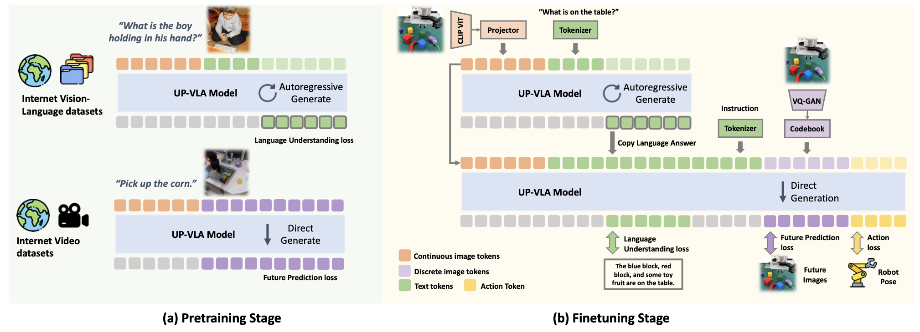
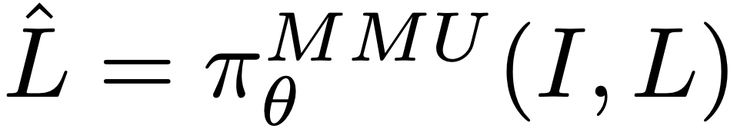
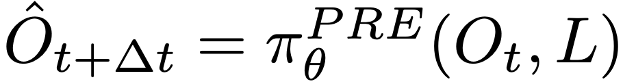
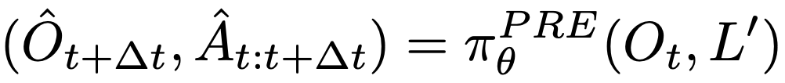
03
UP-VLA framework
• Multi-modal Understanding:
Given a paired image-text question-answering set (I,L):
• Future Visual Prediction:
Given an image and instruction pair (Ot , L) at time t:
• Enhancing Action Learning with Joint Prediction and Understanding:
Zhang et al., UP-VLA: A Unified Understanding and Prediction Model for Embodied Agent, ICML 2025

Slide 4
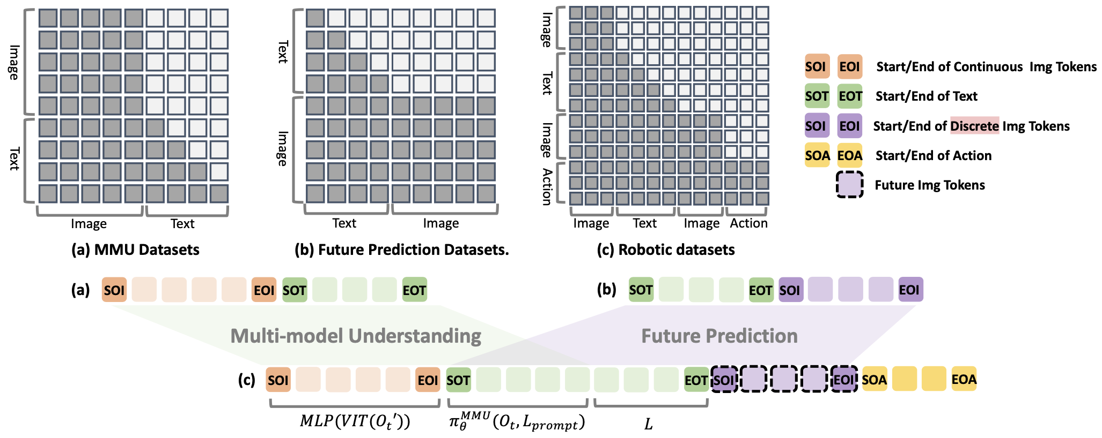
04
Implementation details
Multi-modal Understanding:
• Continuous image token for better understanding
• Image token before text token: focusing on the image while comprehending the language
Future Visual Prediction:
• Discrete image token for better image reconstruction.
• Image token after text token: enabling the image to attend to all input information
Jointly learning:
• Tokens from both tasks are concatenated, allowing actions to attend to both high-level scene understanding and low-level visual information
Zhang et al., UP-VLA: A Unified Understanding and Prediction Model for Embodied Agent, ICML 2025

Slide 5
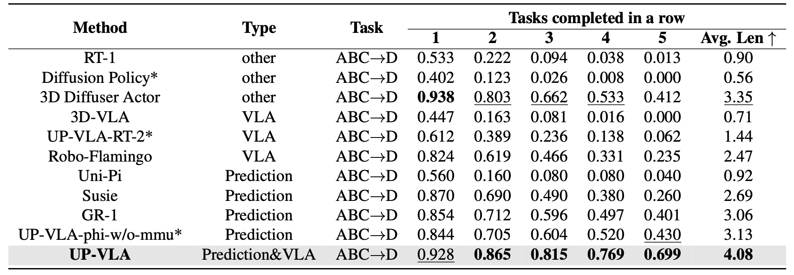
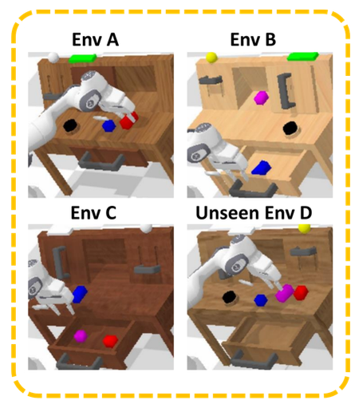
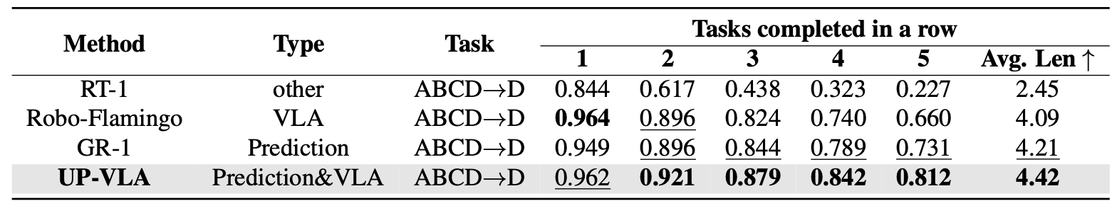
05
Simulation evaluation on Calvin benchmark
Zhang et al., UP-VLA: A Unified Understanding and Prediction Model for Embodied Agent, ICML 2025

Slide 6
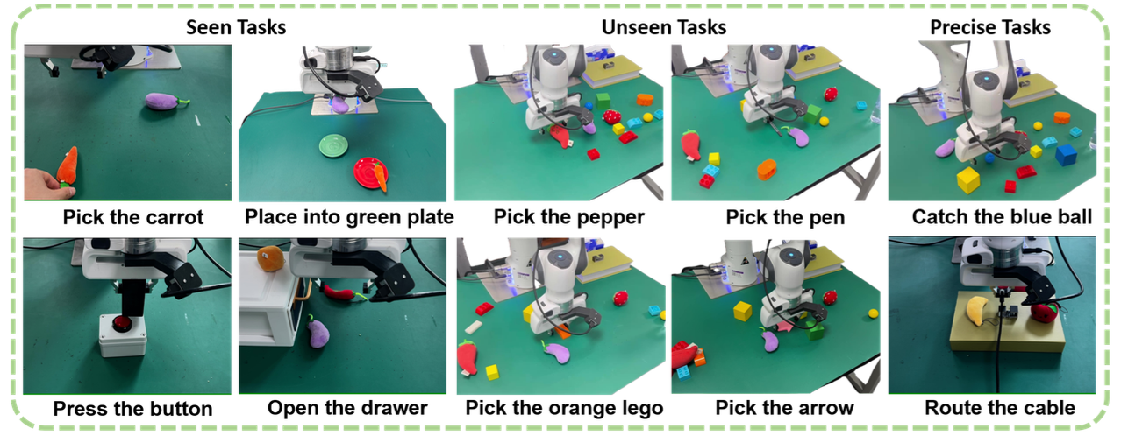
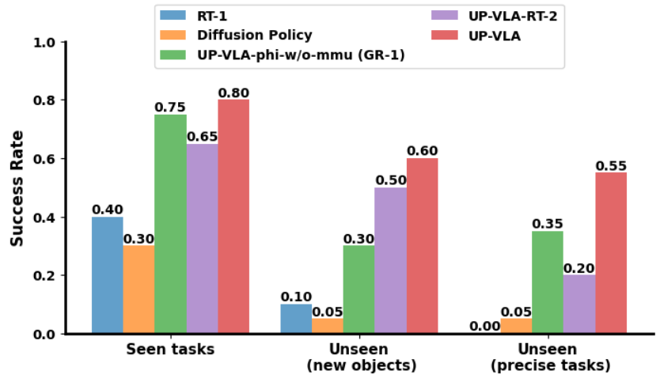
06
Real robot evaluation on Franka-Emika Panda robot
over 2k demonstrations above 6 skills
Zhang et al., UP-VLA: A Unified Understanding and Prediction Model for Embodied Agent, ICML 2025

Slide 7
07
Takeaways
• A unified training strategy
• High-level semantic content and low-level visual and spatial details are both crucial for accurate robot control.
• Jointly modeling understanding and future image prediction helps.
Zhang et al., UP-VLA: A Unified Understanding and Prediction Model for Embodied Agent, ICML 2025

